Slide 1






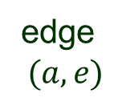

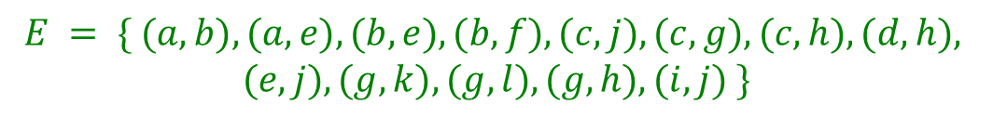









Graph
A graph$G=$ a set $V(G)$ of vertices (nodes)
+ a set $E(G)$ of edges (pairs of vertices)
vertex
$a$
$$b$$
$$c$$
$$d$$
edge
$$(a, e)$$
$$e$$
$$f$$
$$g$$
$$h$$
$$i$$
$$j$$
$$k$$
$$l$$
$$V = \{ a, b, c, d, e, f, g, h, i, j, k, l \}$$
$$\left|V\right|=12$$
$$E = \{ (a, b), (a, e), (b, e), (b, f), (c, j), (c, g), (c, h), (d, h),$$
$$(e, j), (g, k), (g, l), (g, h), (i, j) \}$$
$$\left|E\right|=13$$

Slide 2
A Directed Graph
In a directed graph (digraph), edges are ordered pairs.
DL 435
BOS
ORD
AA 2175
SFO
JFK
AA 1086
DL 434
UA 5654
UA 3606
UA 293
AA 1223
MIA
AA 2467
AA 207
LAX
DFW
AA 2435

Slide 3
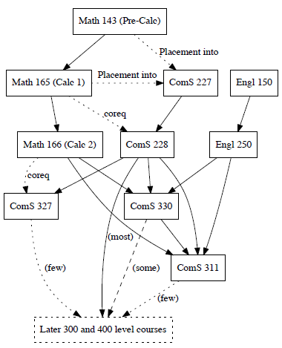
Course Prerequisites

Slide 4

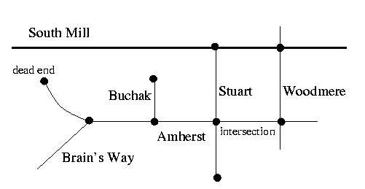
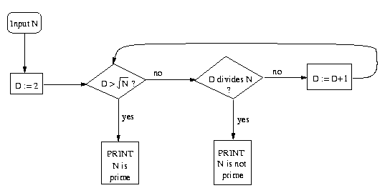





Applications of Graphs
Graphs describe relationships
The Internet
Streets / Highways (Roadmaps)
Molecules
George
Flow Charts
Paul
Social Networks
Geometric Surfaces (CAD)
Linda
Circuits
Parts in an Assembly
Yoko
Ringo
…
John

Slide 5



More General Graphs
A multipgraph allows multiple edges between two vertices.
$$a$$
$$c$$
$$b$$
$$d$$
$$f$$
A pseudograph is a multigraph that allows loops (edges from a vertex
to itself).
1
2
3
4
5
6

Slide 6



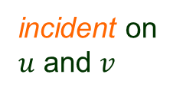






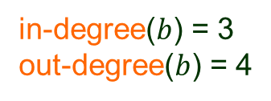




Edges & Degrees
deg($w$) = 1
$$e_{2}$$
$$w$$
$$u$$
$u$ and $v$ are adjacent
degree($u$) = 2
endpoint
$$e_{1}$$
$$v$$
incident on
$u$ and $v$
in-degree($b$) = 3
out-degree($b$) = 4
$$c$$
source
$$b$$
$$a$$
$$e$$
destination/target
$$d$$

Slide 7

Handshaking Theorem
Let $G = (V, E)$be an undirected simple graph.
∑
Every edge contributes 1 to each of
the degrees of its endpoints.
deg(v) = 2 | E |
v ∈ V
v
deg(u) = 1
deg(w)=deg(x)=2
deg(v) = 3
u
x
w
If $G$ is directed:
(1+2+2+3)/2 = 4 edges
∑
∑
in-deg(v) = out-deg(v) = | E |
v ∈ V
v ∈ V
Every edge contributes 1 to the out-degree of its
source and 1 to the in-degree of its destination.

Slide 8








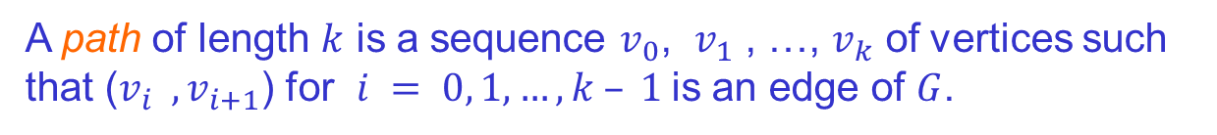

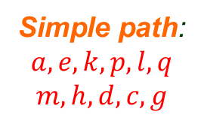





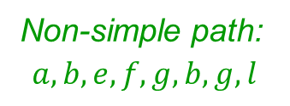



Path
A path of length $k$ is a sequence $v_{0}$, $v_{1}$ , …, $v_{k}$ of vertices such
that ($v_{i} , v_{i+1}$) for $i = 0, 1, …, k – 1$is an edge of $G$.
$b, c, d$not a path
$$a$$
$$b$$
$$c$$
$$d$$
Simple path:
$$a, e, k, p, l, q$$
$$m, h, d, c, g$$
$$e$$
$$f$$
$$g$$
$$h$$
(no repeated
vertices)
Non-simple path:
$$a, b, e, f, g, b, g, l$$
$$j$$
$$k$$
$$l$$
$$m$$
$$n$$
$$o$$
$$p$$
$$q$$

Slide 9
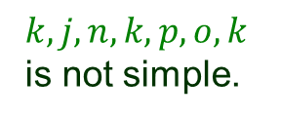
Cycle
A cycle is a path that starts and ends at the same vertex.
A simple cycle has no repeated vertices.
a
b
c
d
e
f
$$g$$
h
j
k
l
m
$$k, j, n, k, p, o,k$$
is not simple.
n
o
p
q

Slide 10

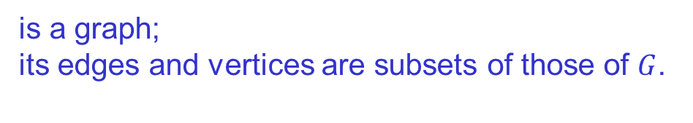
Subgraph
A subgraph $H$ of $G$
is a graph;
its edges and vertices are subsets of those of $G$.
a
b
c
d
e
f
$$g$$
h
j
k
l
m
n
o
p
q
$V(H)$ $= \{b, d, e, f, g, h, l, p, q\} E(H)$ = $\{(b, e), (b, g), (e, f), (d, h), (l, p), (l, q)\}$

Slide 11












Connectivity
$G$ is connected if there is a path between every pair of vertices.
$$a$$
$$d$$
$$b$$
$$c$$
$$f$$
$$e$$
If $G$ is not connected, the maximally connected subgraphs are the
connected components of $G$.
C
3
C
2
C
$$a$$
1
$$d$$
$$e$$
$$f$$
$$g$$
$$b$$
$$a$$
?
not maximally
connected
$$c$$
$$d$$

Slide 12


Is a Tree Connected?
Yes, and $| E | = | V | – 1$.
#edges #vertices
If $G$ is connected, then $| E | ≥ | V | – 1$.

Slide 13

Strong & Weak Connectivity
A directed graph is strongly connected if every two vertices are
reachable from each other.
?
b
a
b
a
e
e
f
c
d
d
c
$c$ unreachable from others
It is weakly connected if the underlying undirected graph is connected.
c
c
f
a
f
b
b
a
e
e
d
d

Slide 14
Weighted Graphs
Ex. Home construction schedule
Outside
Plumbing
Inside
Plumbing
9 days
10 days
5 days
8 days
Framing
21 days
End
Start
7 days
19 days
12 days
6 days
2 days
Concrete
Sewer
Connection
Roofing

Slide 15
Input and Output of Graphs
4
Input data:
B
2
3
A
5 // 5 vertices
A B C D E
6 // six edges
A B 4
A C 7
A D 6
B A 2
C B 3
C E 2
D E 4
E C 1
7
6
1
C
4
D
E
2
Output:
A: in-degree 1 out-degree 3
Edges: B (4) C (7) D(6)
B: in-degree 2 out-degree 1
Edges: A (2)
C: in-degree 2 out-degree 2
Edges: B (3) E (2)
D: in-degree 1 out-degree 1
Edges: E (4)
E: in-degree 2 out-degree 1
Edges: C (1)

Slide 16
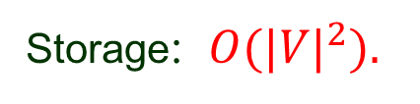

Adjacency Matrix
bool A[n][n];
1
true if $(i, j) ∈ E(G)$
A[i][j] =
0
2
false otherwise
0 1 2 3 4
4
3
0 false true true false true
1 true false true false false
2 true true false true true
3 false false true false true
4 true false true true false
Storage: $O({|V|}^{2}).$
Preferred when the graph is small or dense.

Slide 17

Adjacency Set / List
Vertices Set of Neighbors
B
A
B
2
C
5
E
7
2
6
5
B
A
2
C
6
A
C
C
A
5
B
6
D
10
E
3
7
3
10
D
C
10
E
2
E
D
2
E
A
7
C
3
D
2
If $G$ is directed, the total length of all the adjacency lists is $| E |.$
If $G$ is undirected, the total length is $2 | E |.$
Space requirement: $O(|V| + |E|).$Preferable representation.

Slide 18
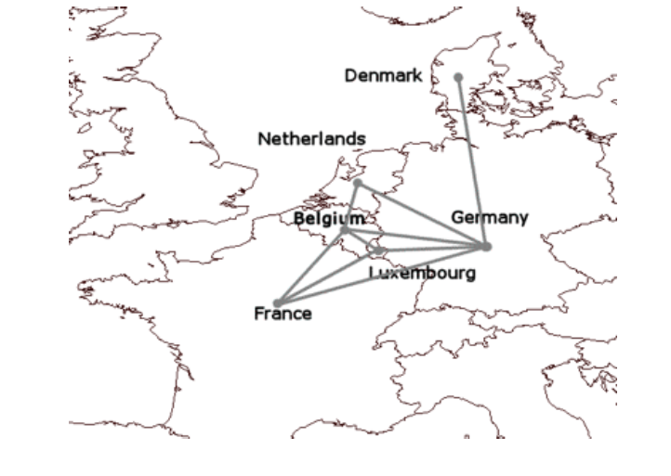
Adjacencies Between Countries

Slide 19
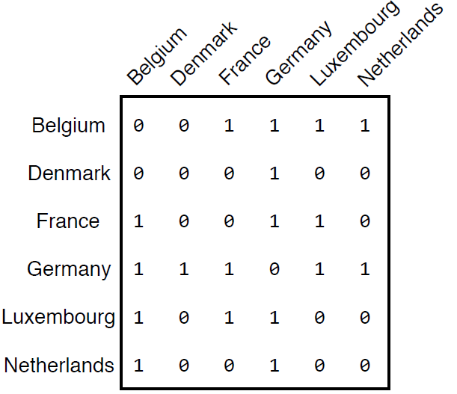
Adjacency Matrix

Slide 20
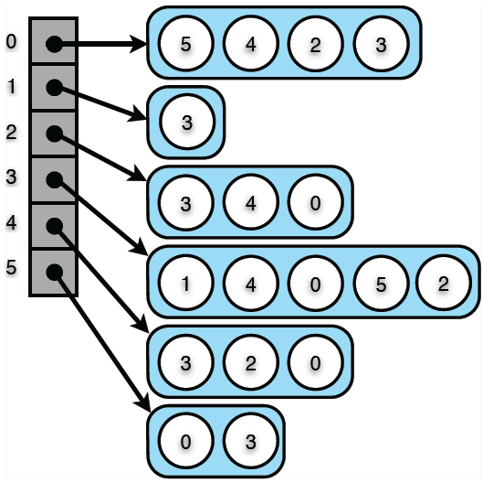
Adjacency List
Belgium = 0
Denmark = 1
France = 2,
Germany = 3
Luxembourg = 4
Netherlands = 5

Slide 21


Operation Time
Operation Adjacency List Adjacency Matrix
Scan incident edges $O(deg⁡(v)) O(|V|)$
Scan outgoing edges $O($out-deg$⁡(v)) O(|V|)$
Scan incoming edges $O($in-deg$⁡(v)) O(|V|)$
Test adjacency
of $u$ and $v$
$$O(min⁡(deg⁡(u), deg⁡(v)) O(1)$$
Storage $O(|V|+|E|) O(|{V|}^{2})$

